Slide 1

Project Based Learning Presentation On,
HOTEL BOOKING MANAGEMENT SYSTEM
Group - 8

Slide 2
Team: Vedika Hardikar TY_CSE_20 Shivam Hasurkar TY_CSE_22 Sharvaree Nabar TY_CSE_34 Naela Naikwade TY_CSE_35

Slide 3
Objectives:
This service shall provide service to on-line customers, employee and administrators.
To offer easy, simple and quick booking experience to the guests.
To provide a platform to manage on-desk and online bookings.
To display organized information of hotel, prices and pictures.
They can search, book the room or cancel the booked room on the Reservation site

Slide 4
Objectives:
Customer information will be stored which can be accessed anytime.
A user-friendly interface for customers for the easy booking process.
To understand the fundamental concepts of SQL and its implementation
It provides an easy way to book hotel room without wasting time and energy.

Slide 5
Introduction
It is popular method of booking rooms.
The owner of the hotel can add multiple rooms to the system, also can change prices of hotel rooms when needed.
It will provide pictures of the hotels and rooms that are available in particular location.
The system will manage all the data like customer information, booking date, check in date, checkout date.

Slide 6
Customer can get knowledge of the hotel by using this online travel agency to compare prices and facilities at different hotels.
Customer will be categorized into family and company.
The type of accommodation will be suggested by the hotel based on the room types.

Slide 7
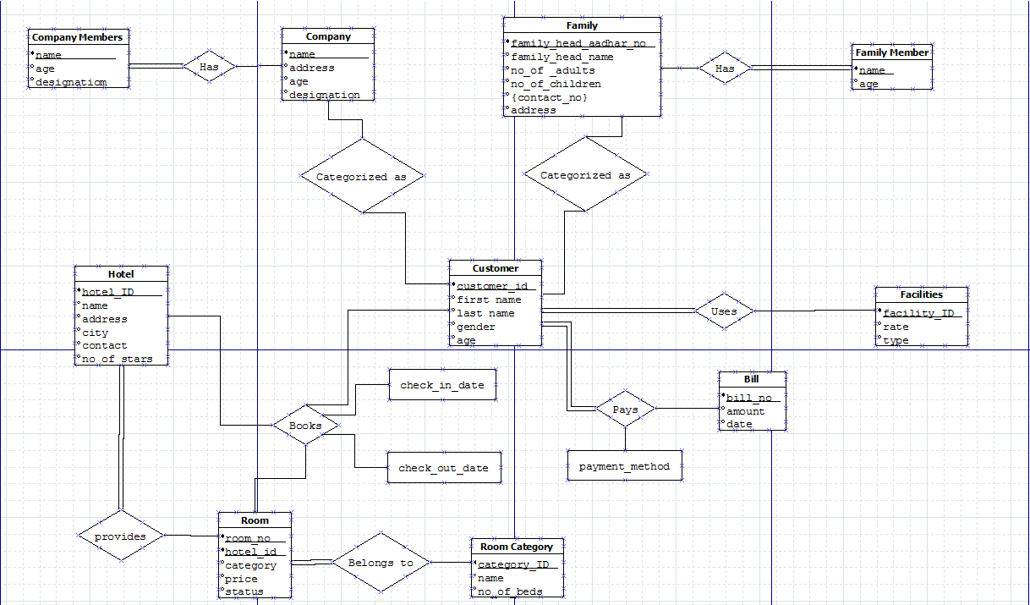
ER Diagram

Slide 8
Plan of Work
Team Formation: (02nd week) 3rd August 2019
Discussion on Problem for PBL: (03rd Week) 21st August 2019
PBL Presentation: (05th Week) 01st September 2019
completion for correction : (06th Week)
Project Progress Presentation: (10th Week)
Completion/ Improvements: (11th Week)
Final Presentation:(13th Week)

Slide 9
THANK YOU

